Slide 1



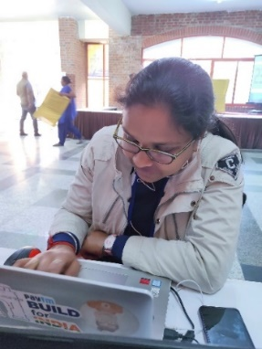



Lowe’s Campus Hackathon
Team Tech Army
Final Presentation
AKASH BAJPAI
ISHA BANSAL
IT – 3rd YEAR
IT – 3rd YEAR
Solution Structure
Backend working
Miscellaneous Stuff
Problem statement
Obstacles we faced
Essential features

Slide 2
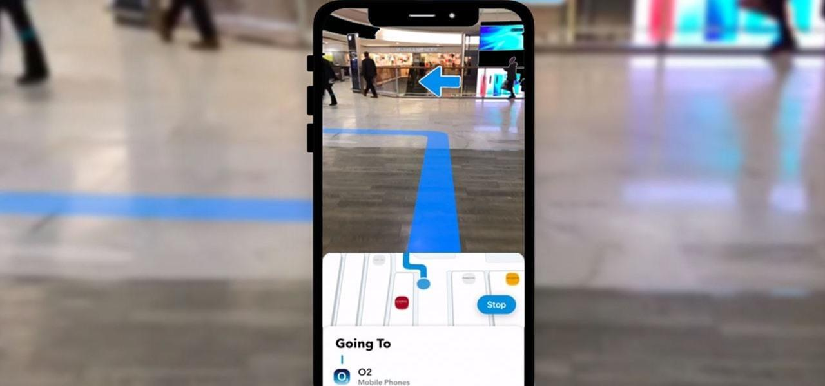
PROBLEM STATEMENT
Build a solution to help the customers find products in the store and help them navigate to the corresponding aisle/shelf. If there is a shopping list, provide the best shopping trip to complete the purchases.

Slide 3
Volunteer Map Creation Not
Possible
No Indoor Map data available
1
5
2
PROBLEM
How To Make It Interactive And Convenient
How To Find The Shortest Path To Destination
T
4
3
2D Navigation
Is Difficult To Understand

Slide 4

PRESENTING TO YOU
An augmented reality based indoor navigation system by Tech Army

Slide 5
There are no maps or path’s data available for inside of all the buildings
Thus, we have to give ability to the place owners to create paths in the area and define and map.
This will be a one time process and would take about 5-6 minutes to map a floor, and thus would be most feasible as it will increase accuracy.
Thus two versions of the app will be shipped, one for the Wanderers, to navigate in the store, while other for the creators to create a map.
Creators
Wanderers
LEARNING
SUCCESS
TINYPPT designed template for presentation in PowerPoint
TINYPPT designed template for presentation in PowerPoint

Slide 6

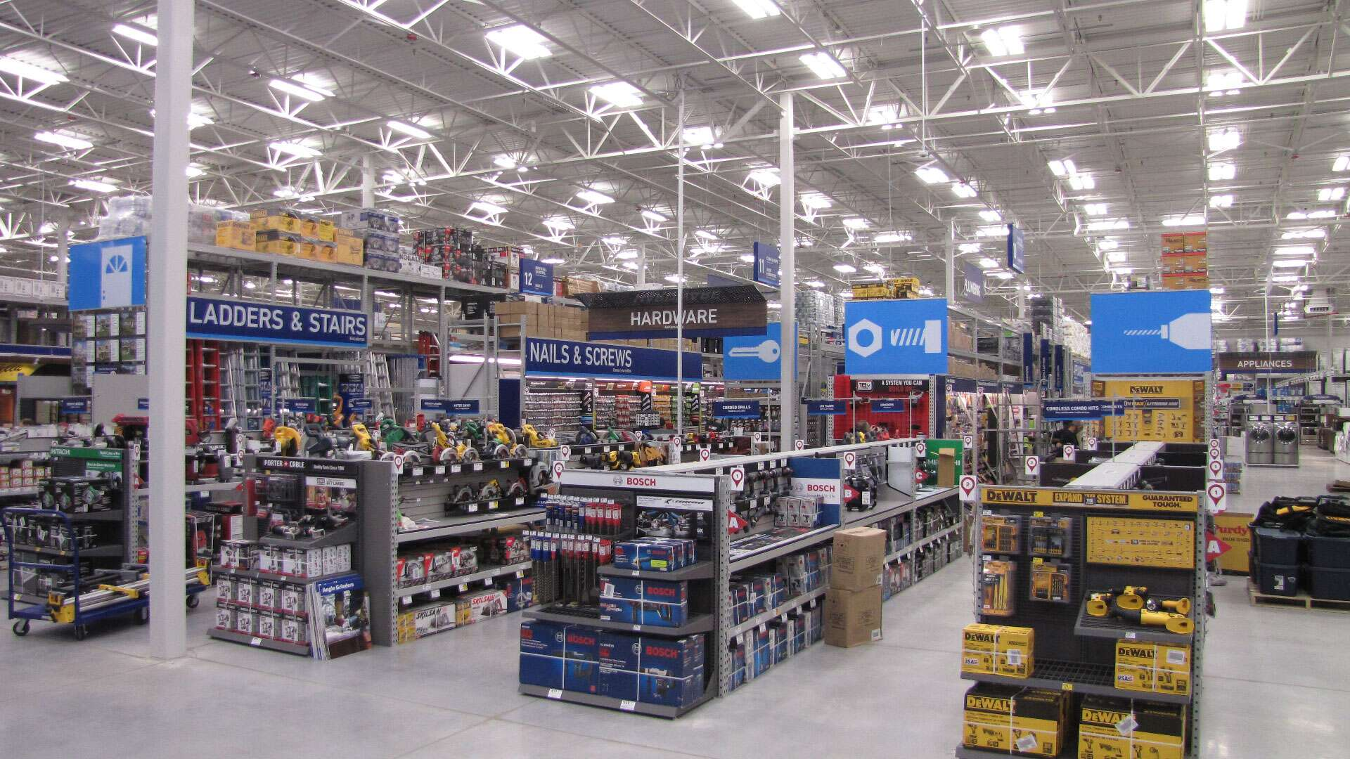
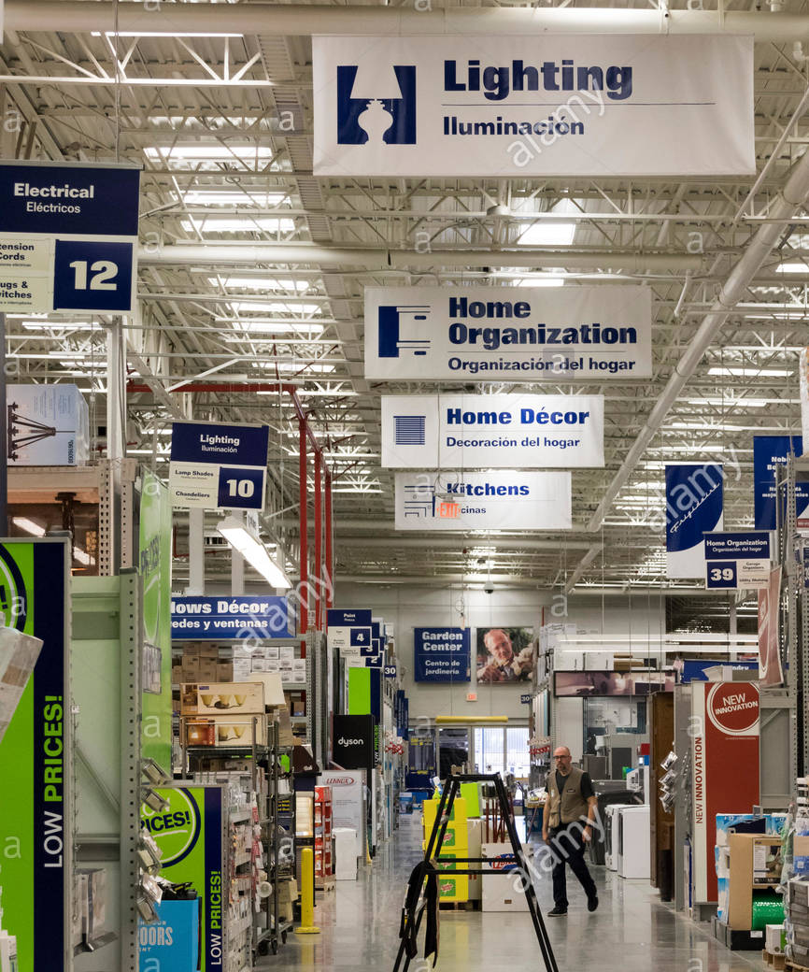
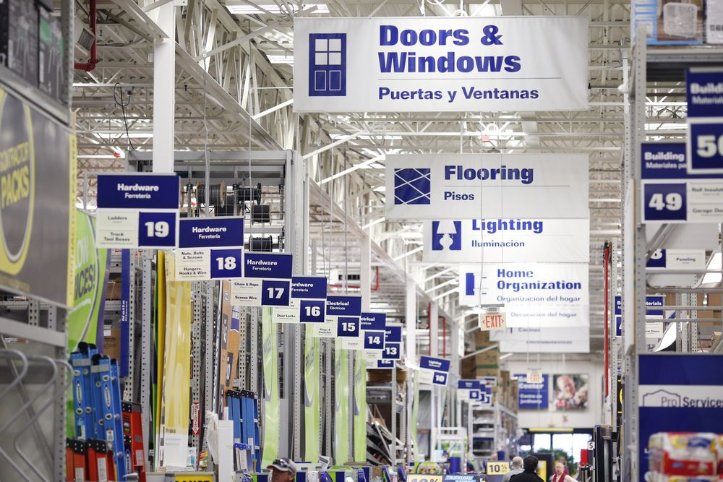
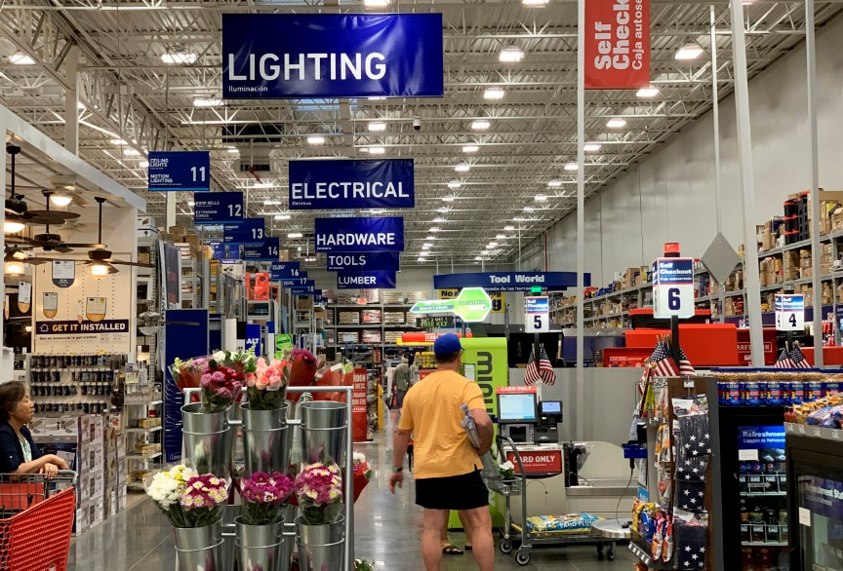
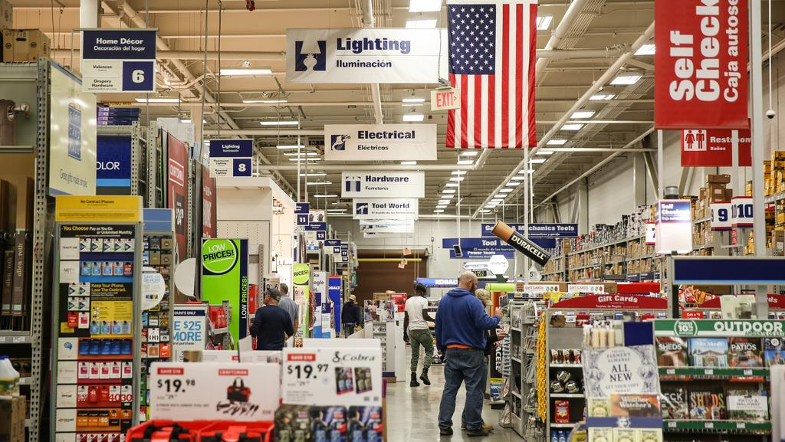
We searched through internet of how Lowe's stores are arranged, how products are generally organized.
This would help us in tuning the solution. The division of sections and the arrangement of products seems very organized
Thus the solution need to have additional features to make the final application more useful for the users.

Slide 7

Disadvantages
Which tracking
technique to use?
01
using
Most of the stores in chains look the same across cities, so the app will fail on large scale implementation.
Very few devices supported(Mostly iPhone).
Third Party licenses needed for some assets.
OPTION
1
SCENE
RECOGNITION
OPTION
Eg. Placenote
Disadvantages
using
02
GPS Tracking
OPTION
No details of indoor maps available, also many stores have multiple floors, causing failure.
Mostly looses accuracy so can cause error when places are within a meter, small disturbance isn’t tolerable
2
OPTION
Eg. Google Maps
Disadvantages
Requires additional hardware to be placed and configured.
Not all store will take efforts to install hardware, as it would cost them in addition to software.
OPTION
03
using
3
Beacons
(Bluetooth/Wi-Fi)
OPTION
Eg. viewAR
using
OPTION
04
Localization
Tracking
4
OPTION

Slide 8
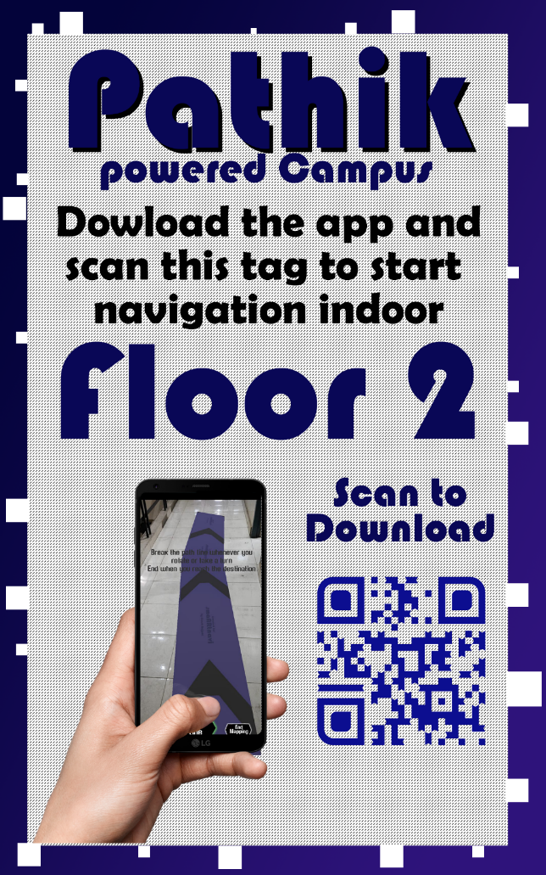
smARt tag based
Localization Technique
Box cuts at border for unique identification of various floors/places
Just Scan a Tag at the entrance and your device is localized to the Map, thus positioning you at a particular place in the Map.
These Tags will be AR markers having unique border boxed coding to identify his location.
Does not add any heavy cost as no hardware devices are used in here.
Can be easily used in multiple floors of same store with same GPS coordinates.
Can be implemented in non-AR Core devices (however this app is made using AR Core but same app can be developed without AR Core as well as no plane detection or other AR Core features, just accelerometer and gyroscope.)
Sample smARt TAG

Slide 9
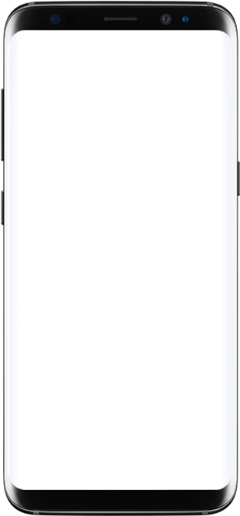
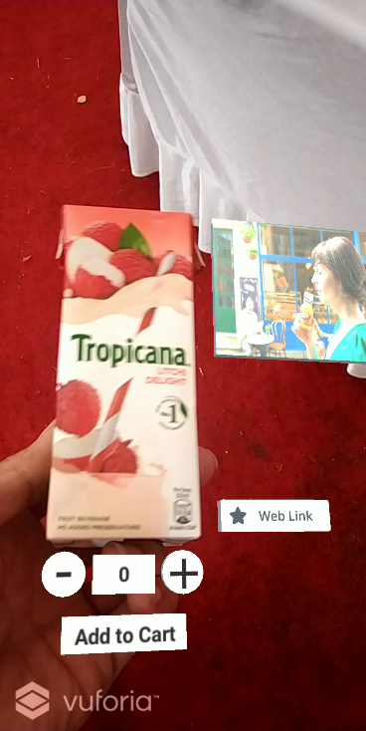
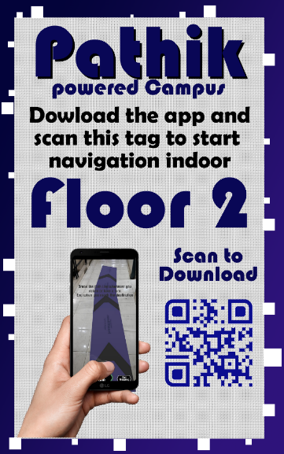
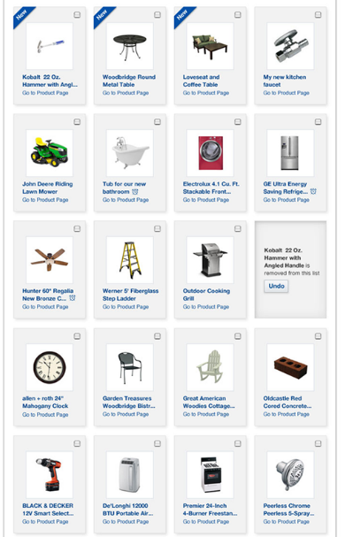
Stepwise Working of the solution
Users Point Of View
1.
2.
3.
Scan the Tag
Select you Products
Follow the path
4.
Add the product

Slide 10




Developers Point Of View
User Logged in with unique Session ID on scanning and location stored
All products data being fetched in background with image and price which are in stock in the store.
Map of the Store downloaded in XML form and unpacked.
1.
Scan the Tag
2.
3.
4.
Select you Products
Follow the path
Add the product

Slide 11
Developers Point Of View
All the selected products added via index to the array of destinations
and passed to the navigation algorithm.
Shortest Path which contains all the products added is computed and the path is set active in scene.
Specific instructions based on the no., type, size etc. of products . For eg. If total size or weight is greater than a limit, ask to take a cart.
1.
Scan the Tag
2.
3.
4.
Select you Products
Follow the path
Add the product

Slide 12
Developers Point Of View
As the user reaches a product he/she is prompted to scan and add the product to his cart/bill.
The Barcode/QR of the products can be used and thus reducing the waiting time of customers.
The path to next products is being displayed continuously, so the customers user experience is great.
1.
Scan the Tag
2.
3.
4.
Select you Products
Follow the path
Add the product

Slide 13
Video Section

Slide 14
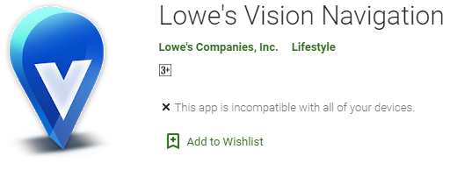

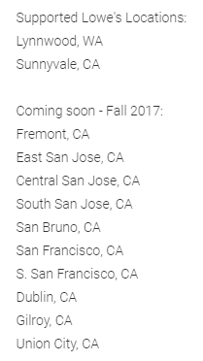
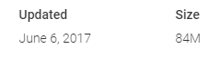
To our surprise
Lowe’s Innovation Labs Worked on a similar product in 2017 names Lowe’s Vision which was quite similar to what we are working on. This project was then tested at two locations in U.S. and gained quite a limelight on net.
The app seems to be in the garage for the last three years and the expansion process is on halt.

Slide 15






How our solution could take Vision’s legacy ahead?
The app has been created with the intension to ensure the data stored is secure and is hash coded for authentication.
The app is highly extensible which ensures even if the number of concurrent users of the app take a hike suddenly, it wont effect the working of the application as the map data is locally stored on the device.
Vision was accessible to only one consumer facing device Lenovo Phab 2 Pro thus could be used by a few thousand people only.
Our solution can be access by 500 million users across globe with AR Core supported phones, and we will remove that restriction too expanding userbase to billions of users.
EXTENDED USERBASE AND USER FRIENDLY
Stores are not constant in manner of arrangement and the no. of products currently in store.
We provide ability to customize the Map very easily with creators App if a shelf is moved, a new shelf is added or one is removed.
The store manager can do it in few seconds in the app and it is updated instantly.
The Lowe’s Vision app had a size of about 85MB with only 2 stores data to handle, this size would increase with adding more stores.
We would be shipping our App in just 35-40MB size and a few KB internet download(once) for the map would do.
Does not require any technical equipment and experts to visit the site to map the place.
The process is extremely quick, easy and convenient than using SLAM to uniquely map each and every corner of the store.
EXTREMELY LOW APP SIZE, DATA CONSUMPTION
QUICKER AND EASIER TO IMPLEMENT IN STORES
HIGHLY CUSTOMIZABLE AND STORE FRIENDLY
COMPLETELY SECURE AND EXTENSIBLE
Notes:
The Lenovo Phab 2 Pro is the only consumer-facing device that has Tango, so Lowe’s is allowing shoppers to borrow the device from store associates to use in stores

Slide 16





FEATURES
SHORTER
NAVIGATION
PATHS
AUDIO ASSISTANT
& 3D GUIDE
INTEGRATED
SHOPPING
EXPERIENCE
COMPLETELY
CLOUD BASED
AND SECURE
AUTO LOCATION DETECTION

Slide 17

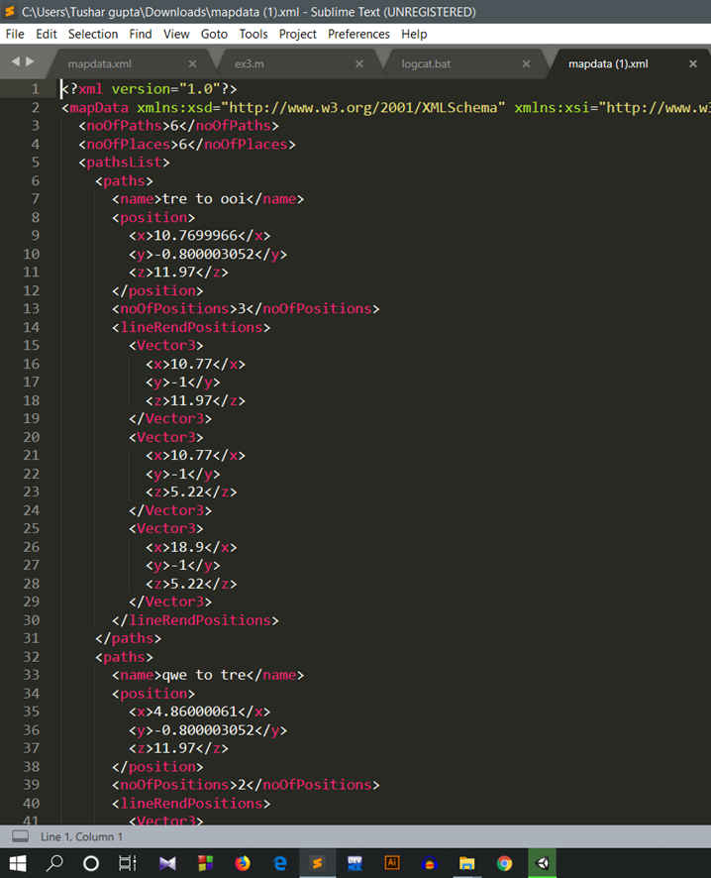
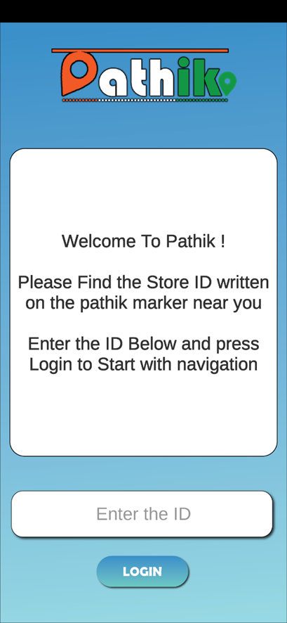

COMPLETELY CLOUD BASED
HIGHLY
SCALABLE
01
EXTREMEL LOW SIZED
02
03
RE-EDITABLE
04
SAFETY OF
DATA

Slide 18
A complete Indoor navigation project for your store to improve the customer engagement and help them to find the right product in No Time!

Slide 19
Thank
You

